Slide 1
Trends in Reserve and Transition Studies
H. Alan Mooney, P.E., RS
Criterium Engineers
A Special Thank You to our Program Sponsors

Slide 2
Our Objectives for Today
What is a 2021 Reserve Fund Study? The definition has drifted.
The pros and cons of the current CAI Reserve Fund Study standards
The benefits and pitfalls of a Reserve Fund Study by any standard

Slide 3
Our Objectives for Today
Current trends in the Association Board’s expectations of a Reserve Fund Study
The value of collaboration between the Board and the Reserve Specialist.
The difference between a Reserve Fund Study and a Maintenance Plan

Slide 4
Our Objectives for Today
Current trends in Transition Studies
Becoming more adversarial

Slide 5
The Birth of Community Associations
Common interest developments date back to 1963 in California. However, they were fragmented.

Slide 6
Davis–Stirling Common Interest Development Act in 1985.
In 1985 California Assemblymen drafted and passed an act that created a comprehensive body of law governing common interest developments.
An explosion was triggered.

Slide 7
Community association growth
Year | Communities | Units | Residents
1970 | 10,000 | 700,000 | 2.1 million
2000 | 222,500 | 17.8 million | 45.2 million
2019 | 351,000 | 27.2 million | 73.9 million

Slide 9
Reserve Fund - Current
What is it?
A cash reserve for non-annual, expected, predictable expenses
Special assessments are to be avoided

Slide 10
What are General Accounting Practices (GAP)?
Prudent guidelines
Established standards of practice
Defendable actions
The starting point for good financial management

Slide 11
Reserve Fund
Funding methods
Cash flow
Component
More later…

Slide 12
Vocabulary
Capital Improvement Fund
Things you would like to do

Slide 13
Vocabulary
Capital Reserve Fund
Things you plan to do
Things you need to do

Slide 14
Vocabulary
Preventative Maintenance
A good thing to control cost and avoid surprises
Recommend maintenance contracts for accountability

Slide 15
Vocabulary
Reactive Maintenance
“If it ain’t broke, don’t fix it.”
Not defendable management

Slide 16
Vocabulary
Annual Maintenance
Not part of Reserve

Slide 17
Reserve Fund
What it isn’t…
It is not a maintenance plan
But not everyone agrees.

Slide 18
Vocabulary
Expected Useful Life (EUL)
Remaining Useful Life (RUL)
Estimates, based on professional,
experienced judgment.
The heart of a Reserve Fund Study

Slide 19
Vocabulary
Upgrade
To actually improve the system based on current technology
How do upgrades and renovations fit with a Reserve Study?

Slide 20
Reserve Fund Account
Fund account options
Separate account
Trust account
Mixed with general funds
Separate account is best

Slide 21
Types of Reserve Studies
CAI Best Practices Document
Best Practices for Reserve Study/ Management
Published by the Foundation for Community Association Research

Slide 22
Types of Reserve Studies
CAI Type I: Full Reserve Study
“The reserve provider conducts a component inventory, a condition assessment (based upon on-site visual observations), and life and valuation estimates to determine both a fund status and a funding plan.”

Slide 23
Types of Reserve Studies
CAI Type II: Update with Site Visit
“The reserve provider conducts a component inventory (verification only, not quantification), a condition assessment (based on on-site visual observations), and life and valuation estimates to determine both a fund status and a funding plan.”

Slide 24
Types of Reserve Studies
CAI Type III: Update with No Site Visit
“The reserve provider conducts life and
valuation estimates to determine a fund status
and a funding plan.”

Slide 25
Types of Reserve Studies
IV. Preliminary, Community Not Yet Constructed. A reserve study prepared before construction that is generally used for budget estimates. It is based on design documents such as the architectural and engineering plans. The following three tasks are performed to prepare this type of study.
Component inventory
Life and valuation estimates
Funding plan

Slide 26
Types of Reserve Studies - Enhanced
In addition to the scope of work included in the Full Reserve Study, some firms offer associations an “Enhanced Reserve Study.”
The Enhanced Reserve Study could include additional analysis of building and site systems which may not be included within the schedule. This inspection would provide recommendations for ongoing maintenance of all systems as well as a more complete condition evaluation of each in a detailed narrative report.

Slide 27
Four consequences of under-reserving
Deferred maintenance
Need for special assessments or loans
Lower property values
Liability exposure

Slide 28
How Are Cost Estimates Determined?
Quantity
Local unit prices
Professional judgment
Objective, defendable

Slide 29
How Are Cost Estimates Determined?
Are they guaranteed?
No; many things change
Get contractor proposal for certainty
From someone willing to do the work
From someone qualified to do the work

Slide 30
Tips for Reserve Funding
Include all components
Include demo and disposal costs

Slide 31
Prudent Board Actions
Review your responsibilities
Make “right” (not necessarily popular) decisions
Become well versed in the Business Judgment Rule (BJR)

Slide 32
Business Judgment Rule
Limits the Board’s decision-making liability when acting…
within their power
after reasonable inquiry
in best interests of Association

Slide 33
It’s just good management
Reserve expenses are not discretionary
Somebody pays them all!
“Board members in underfunded associations are sitting ducks for lawsuits.”
- Anonymous Attorney

Slide 34
Funding Options

Slide 35
What is the Basis?
Cash Flow
Component
Trending toward “adequate” funding
A much debated topic…

Slide 36
Definitions
Cash Flow Method – A method of developing a reserve funding plan in which contributions to the reserve fund offset the variable annual expenditures from it. Different reserve funding plans are tested against the anticipated schedule of reserve expenses until the desired funding goal is achieved. The Cash Flow method permits all of the reserve funds to be pooled such that the total available reserve balance can be used to meet the projected expenditures of any reserve component.

Slide 37
Definitions
Component Method – A method of developing a reserve funding plan in which the total contribution is based on the sum of contributions for individual components. The Component Method, often called the Straight-Line method, provides for the independent funding of each common element. That is, the reserves for each component, or type of component, are calculated separately and funded independently of other components. With this method there is no pooling of reserve funds and each component has to maintain its own reserve balance.

Slide 38
Definitions
Fully Funded Balance (Total Accrued Depreciation) - An indicator against which Actual (or projected) Reserve balance can be compared. The Reserve balance that is in direct proportion to the fraction of life “used up” of the current Repair or Replacement cost. This number is calculated for each component, and then summed together for an association total. The method of calculating the Fully Funded Balance is identical to that employed in the Component Method.

Slide 39
Definitions
Funding Goals - Independent of methodology utilized, the following are common terms for funding plan goals:
Baseline Funding – usually keep fund balance above zero
Component Full Funding – another term for 100% fully funded using Component Method

Slide 40
Definitions
Funding Goals - Independent of methodology utilized, the following are common terms for funding plan goals:
Statutory Funding – as may be required by state
Threshold Funding – minimum balance, determined by Association

Slide 41
Reserve Component “Four-part test”
Common area responsibility
Limited useful life
Predictable remaining life
Above a minimum cost

Slide 42
Cash Flow Funding
Item |  | 1 | 2 | 3 | 4 | 5 | 6 | 7 | >>>>>>> | 18
Pool furniture |  | 4,600
Pool resurface |  |  |  |  |  |  | 10,000
Roof replace |  |  |  |  |  |  |  |  |  | 80,000
Asphalt – seal |  |  |  | 5,000
Asphalt – resurface |  |  |  | 25,000
Building – repaint |  |  | 50,000
Elevator – modernize |  |  |  |  |  |  | 80,000
Hallways – refurbish |  |  |  |  |  |  |  | 24,000
Annual Totals |  | 4,600 | 50,000 | 30,000 | - | - | 90,000 | 24,000 | - | 80,000
Opening Balance | 75,000
Annual Contribution |  | 15,000 | 15,000 | 15,000 | 15,000 | 15,000 | 15,000 | 15,000 | 165,000 | 15,000
Cumulative Balance | 75,000 | 85,400 | 50,400 | 35,400 | 50,400 | 65,400 | (9,600) | (18,600) | 146,400 | 81,400

Slide 43
Cash Flow Funding Benefits
Easy to understand
More practical for large asset lists
Funded by uniform contributions
Our general preference

Slide 44
Reserve Component List
Description | UL | RUL | Cost
Pool furniture – replace | 5 | 0 | $4,600
Pool – resurface | 10 | 5 | $10,000
Roof – replace | 20 | 18 | $80,000
Asphalt – seal | 5 | 2 | $5,000
Asphalt – resurface | 20 | 5 | $25,000
Building – repaint | 10 | 1 | $50,000
Elevator – modernize | 20 | 5 | $80,000
Hallways – refurbish | 8 | 6 | $24,000

Slide 45
Fully Funded Balance
Fractional age X Current cost
(Summed for all components)

Slide 46
Description | UL | RUL | Cost | FFB
Pool furniture – replace | 5 | 0 | $4,600 | $4,600
Pool – resurface | 10 | 5 | $10,000 | $5,000
Roof – replace | 20 | 18 | $80,000 | $8,000
Asphalt – seal | 5 | 2 | $5,000 | $3,000
Asphalt – resurface | 20 | 5 | $25,000 | $18,750
Building – repaint | 10 | 1 | $50,000 | $45,000
Elevator – modernize | 20 | 5 | $80,000 | $60,000
Hallways – refurbish | 8 | 6 | $24,000 | $6,000
TOTAL: |  |  |  | $150,350
Fully Funded Balance

Slide 48
Reserve Funding at Association-governed Communities
Well funded – 30%
Under funded – 40%
Severely under funded – 30%
Using Component Method
70%

Slide 49
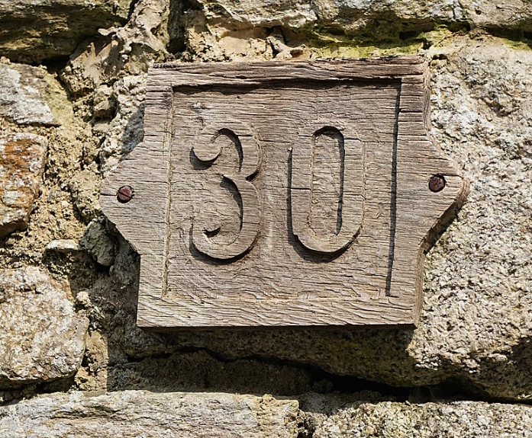
The Big 3-0: Trends
Aging infrastructure
54% of community buildings are at least 35 years old (CAI statistic)
All buildings start to deteriorate the day after construction was completed.

Slide 50
1990
Where were you?

Slide 51
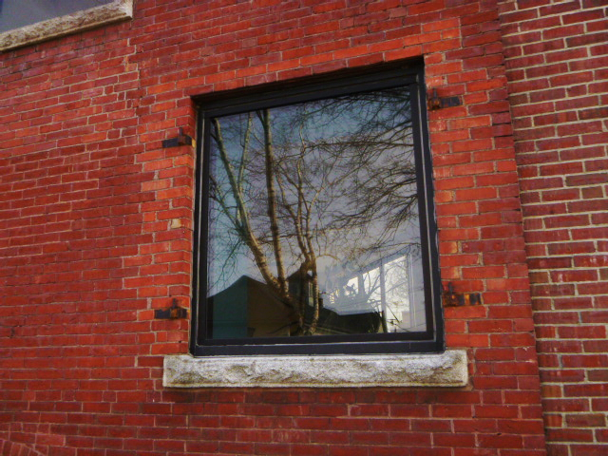
The look ahead changes
After 30 years, the look ahead changes
Siding
Windows
Vertical transportation
Site drainage
Paving

Slide 52
Current tools
Maintenance plan
Annual maintenance, known systems
Reserve fund study
In kind replacement
Known assets
Most Expected Useful Life (EUL) 20 to 30 years
Capital improvements plan
Upgrades

Slide 53
But things change…
Even after 10 years, in kind replacement may not be appropriate
Technology changes
Owner expectations change

Slide 54
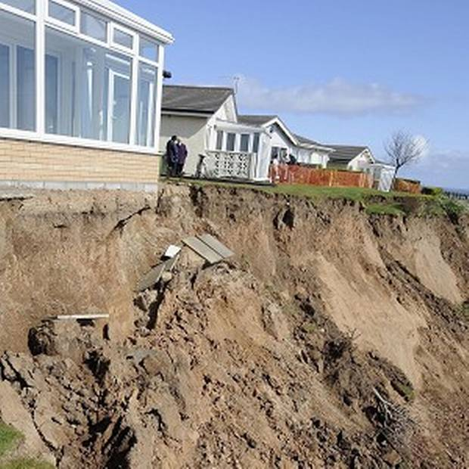
The “out of sight, out of mind” effect
Underground
Corrosion
Flashing
Underlayment
Erosion/Drainage

Slide 55
The “I don’t know what I don’t know” effect
Tile roof underlayment
Cast iron piping
HVAC/ventilation
Effect of water quality

Slide 56
How long?
The expected useful life (EUL) of a building?
Many variables
Generally 50 – 100 years
EUL criteria for most reserve fund study components is 20 – 30 years
Long range plan needed

Slide 57
How long?
What about components with EUL greater than 30 years?
Reserve allowances
Our white paper (available on request)

Slide 58
Establish a building baseline
Core systems
Structure
Building envelope
Walls
Windows
Doors
Roof

Slide 59
What’s missing?
Compare to:
Maintenance plan
Reserve fund study
Asset list
Identify gaps

Slide 60
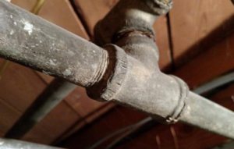
Peel the onion (a few examples)
Plumbing
What kind of pipe?
Where is the pipe?
Effect of water quality

Slide 61
Peel the onion (a few examples)
Windows
Flashing
Seals
Operation

Slide 62
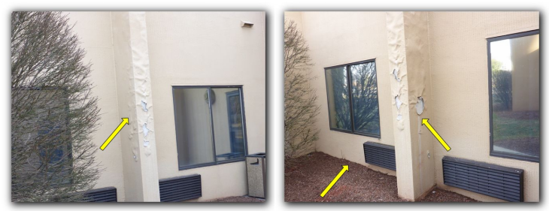
Peel the onion (a few examples)
Building envelope
Brick veneer
EIFS
Composition board
Vinyl

Slide 63
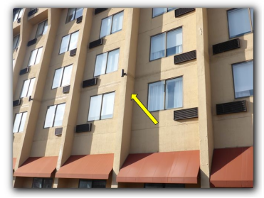
Peel the onion (a few examples)
Building envelope
Cracks
Delamination
Distortion
Water intrusion
Water retention (drainage plane)

Slide 64
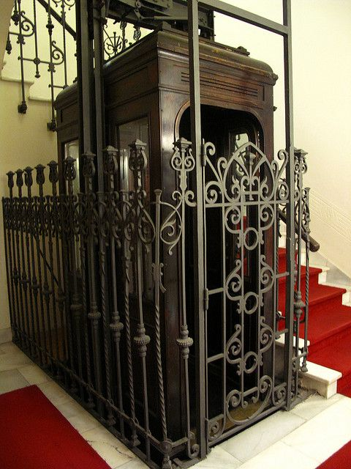
Peel the onion (a few examples)
Vertical transportation
Controls
ADA

Slide 65
A good faith effort
It’s a subjective exercise, but credible
A good faith effort to stay ahead of the curve
The result offers an opportunity to choose
In-kind replacement
Or upgrade

Slide 66
Upgrade Energy Efficiency?
LED lighting
HVAC systems
Lighting and environmental controls

Slide 67
Improve Safety?
Site lighting
Balconies
Railings
Slip resistant surfaces
Tripping hazards

Slide 68
Improve Accessibility
Parking
Signage
Door hardware
Door openers
Restrooms
Pool accessories

Slide 69
Board Challenges
Reluctance to serve
Roberts Rules of Order?
Good intentions, limited experience
Lack of common objectives

Slide 70
Trends in Transition

Slide 71
From Developer to Association

Slide 72
Non Financial Objectives Of Transition Process
Enhance community relations
Minimize controversy
Build trust
Transfer/build skills
Resolve issues before they escalate
Minimize potential claims
Maintain continuity

Slide 73
Transition – The Challenges
Construction Completion
Preparation of Documents
Guidelines for Governance
Communications
Maintenance of Common Property by the Association

Slide 74
Transition – The Challenges
Financial Control
Budgets
Litigation Risk
Engineering Reports and Punch Lists
Insurance

Slide 75
Transition – The Challenges
The trend toward more litigation

Slide 76
Transition – The Challenges
Who’s on your team?
Attorney
Accountant
Engineer

Slide 77
Developer Best Practices At Inception
Team approach
Obtain input from management early
Services to be provided
Staffing
Establish management protocol

Slide 78
Developer Best Practices At Inception
Define as much as possible – including service levels
Prepare an adequate budget that will
Survive builder involvement
Cover operating costs
Unit type fee differentials
Establish reserve fund

Slide 79
Transition – Strategies
Review of the design drawings
Review of the description of the community
Review of the budget
Review of the as-built construction

Slide 80
Transition – Steps
Transition Study – at transition, to confirm project completion
Reserve Study – to plan ahead for non-annual maintenance

Slide 81
Transition to Reserve
Pause to resolve issues

Slide 82
Community Associations Institute (CAI)
What does CAI say?

Slide 83
Transition Study Report
A description of the overall condition of building components and systems that are the responsibility of the Association, and conditions that may limit the expected useful life of the buildings and their components.
CAI Best Practices – Transition

Slide 84
Transition Study Report
Information about significant deficiencies, deferred maintenance items, and material code violations based on a visual survey of the building and grounds, research of documents, and conversations with people who have knowledge about the community.
CAI Best Practices – Transition

Slide 85
Transition Study Report
A transition cost estimate including a list of the individual components and the estimated cost for repair and/or completion of those components to comply with the noted standards.
Optional
CAI Best Practices – Transition

Slide 86
Transition Study Are you getting what you should?

Slide 87
Transition Study
Answer these questions:
1. Reasonable compliance with construction documents
2. Reasonable compliance with good construction practice
3. Reasonable compliance with local regulations

Slide 88
What do we look at?
All the major building systems
Here are a few examples…

Slide 89
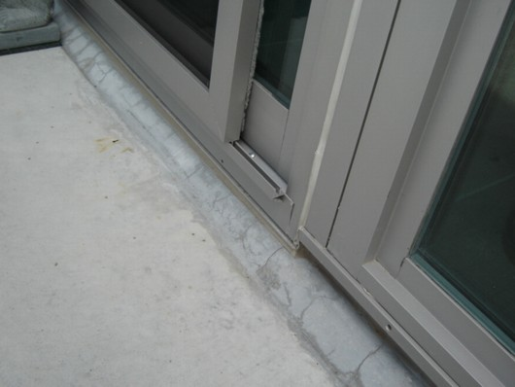
Detail of curtain wall and sliding door threshold at balcony

Slide 90
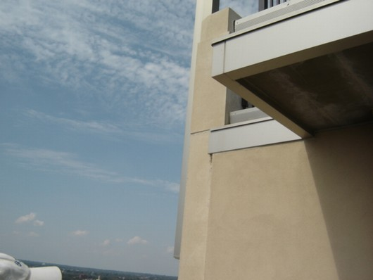
View of underside of metal flashing and
balcony from terrace

Slide 91
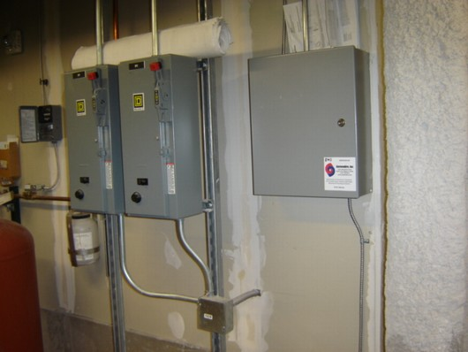
Cooling tower pump controls

Slide 92
What do we look at?
We review the available documents
Plans
Specs
Association documents
Regulatory approvals

Slide 93
Transition Study
The work product?
A full written report
Draft for your review
Possible review by attorney
Final

Slide 94
Realistic Expectations Of The Transition Process
Begin with the end in mind
Cost/benefit of procedures and work of experts
Understand the approach of your professionals
The team must have a captain
Identify issues early on and try to resolve them before transition

Slide 95
QUESTIONS? Thank you!

