Slide 1
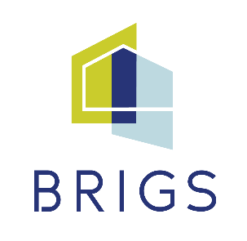
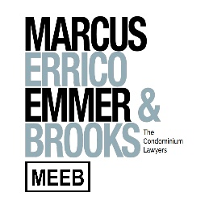
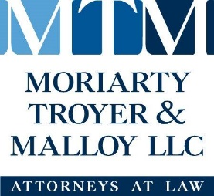
Associations and the “internet of things”
Presented by:
Justin Magsarili Gary Daddario
jmagsarili@meeb.com gdaddario@meeb.com
MARCUS, ERRICO, EMMER & BROOKS, P.C.
A Special Thank You to our Program Sponsors

Slide 2
What is the “Internet of Things” (aka “IoT”)?
All Things “Smart”

Slide 3
Internet connected devices allowing network/internet connections, interactions, and exchange of data.
Ever-growing: light bulbs, kitchen appliances, scales, door locks, garage door openers, doorbells, thermostats, security cameras, cars
Massively popular
Over 10 billion devices by current estimates
Estimated to pass 25.4 billion devices within 10 years.
Likely attractive to associations for convenience and simply to keep up with the times.

Slide 4
Association Devices
SMART LOCKS
SMART THERMOSTATS
SMART SECURITY CAMERAS
VIDEO DOORBELLS
INTERNET ENABLED MOISTURE SENSORS

Slide 5
DEVICE ADVANTAGES

Slide 6
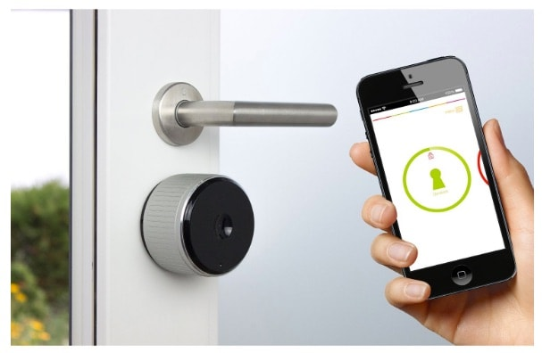
SMART LOCKS
Can provide residents access to common doors via cell phone apps
Save hassle of obtaining and controlling keys for everyone
Residents can remotely provide access for guests without distributing keys

Slide 7
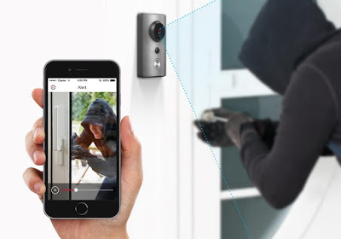
WIRELeSS CAMERAS VIDEO DOORBELLS
Cloud storage, no need for tapes or hard drives
Board or management can access live feed or recordings instantly and from anywhere.
Deter misconduct
Easier setup than wired systems
This Photo by Unknown Author is licensed under CC BY-SA-NC

Slide 8
SMART THERMOSTATS
Easier to program than traditional versions
“Learn” activity patterns and adapt programming
Board or management can check temperature settings remotely and adjust as needed
Board or management can remotely check actual temperature to monitor for potential HVAC failures

Slide 9
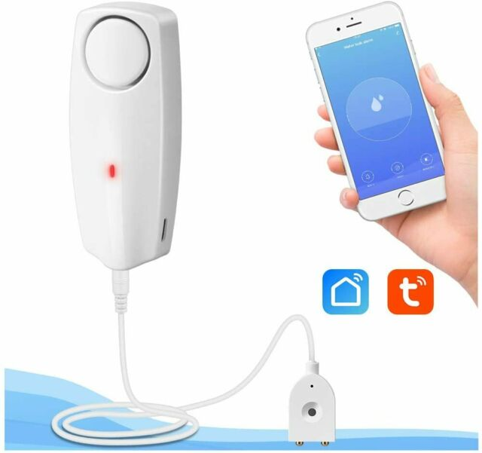
LEAK/MOISTURE DETECTORS
Can provide Board or management with instant alerts of leaks
Some models include temperature monitoring to detect freezing temps
High-end models include water shutoffs

Slide 10
FINANCIALS

Slide 11
Higher initial cost than traditional, non-internet options
May require community authorization
May be required by law
In Massachusetts, may require improvement vote under M.G.L. c. 183A, § 18.
Documents may impose restrictions on improvements
Consult with the association’s counsel

Slide 12
M.G.L. c. 183A, § 18
(a) If fifty per cent or more but less than seventy-five per cent of the unit owners agree to make an improvement to the common areas and facilities, the costs of such improvement shall be borne solely by the owners so agreeing.
(b) Seventy-five per cent or more of the unit owners may agree to make an improvement to the common areas and facilities and assess the cost thereof to all unit owners as a common expense . . .

Slide 13
Certain devices can lead to long term/future savings
Thermostats can help climate control operate more efficiently
Leak detectors, especially with automatic shut-offs, can help limit damage from leaks
Security:
The web is inherently risky
E.g.: Colonial Pipeline shutdown, Massachusetts Steamship Authority
Spambot campaigns
More than 100,000 IoT devices, including routers, smart TV sets, and even a smart fridge, were the subjects of a cyberattack that took over the devices and used them to send out spam emails in massive numbers
Mirai botnet attack
Worked by breaching poorly-secured IoT devices and using them in a coordinated dedicated denial of service (DDoS) attack, which targets a server by simply bombarding with web traffic until it’s overwhelmed and knocked offline.

Slide 14
Smart Locks
Ransomware attack could lock everyone in or out of the building
Hacker could gain access digitally
Internet-connected Cameras
Hackers could access audio/video feeds (and possibly even talk to/harass residents via the device)
Hackers could access recordings stored on the cloud
Smart Thermostats
Hackers can manipulate temperature settings or lock you out of the system

Slide 15
Unit owner convenience and concerns
Smart locks provide ease of building access via smartphones, etc.; Ability to provide access to guests (especially helpful for buildings without intercom buzzer systems)
Concerns regarding overall security of systems
Save the association money, save the owners money (thermostats and leak detectors)
Data privacy concerns
If association installs a smart lock operated through an app on a unit owner’s phone, the app may harvest data from the unit owner’s phone activity, including location history
Freedom to opt-in/op-out

Slide 16
Association Pitfalls and Liability

Slide 17
New and developing area
Can association be held liable for bad acts committed against residents through association devices (that unit owner may or may not have had a say in installing)?
Person hacks smart lock to access building and victimizes residents/units inside
Hacker steals recordings of resident patterns and habits in building
Hacker takes over camera/intercom device and harasses/abuses residents

Slide 18
Most smart devices harvest location, activity, and network activity information, which the manufacturers store
If manufacturer suffers data breach, is association liable to unit owners for their information being stolen?
Nearly 4,000 confirmed data breaches in 2020 alone
Association might face same requirements as the data collector in terms of notifying owners of the breach.

Slide 19
Ransomware attacks
Paying ransoms can lead to fines from federal government
Courts have taken an “in for a penny, in for a pound” approach
Though boards generally not liable for wrongful acts of third party, where boards have dabbled somewhat in security measures, courts have analyzed liability on basis of board involving itself in the matter of security
Private networks made public: Amazon Sidewalk

Slide 20
Final advice

Slide 21
BEST APPROACH:
Identify a product and assess pros and cons. Where consequences may be relatively simple & chance of being targeted is not high, likely worth approaching (e.g, thermostats) Where consequences are greater and chance of being targeted is higher, may want to wait until a more secure product available (e.g., smart locks).
Work with an expert in the field who is familiar with the technology and can provide advice and suggest most secure options.

Slide 22
Q&A
Presented by:
Justin Magsarili
jmagsarili@meeb.com
Gary Daddario
gdaddario@meeb.com
MARCUS, ERRICO, EMMER & BROOKS, P.C.

