Slide 1
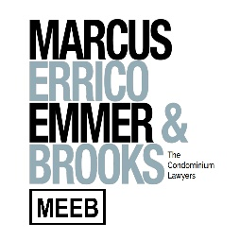
ENERGY EFFICIENCY, COST SAVINGS, & GREEN LENDING TECHNOLOGY & GREEN ISSUES
A Special Thank You to our Program Sponsors

Slide 2
WELCOME TO THE WEBINAR!
GET TO KNOW THE PANELISTS
Rob Holdsworth
MBB, CEM, CEA, CLMP,
LEED AP O+M
VP of Engineering, EEP
rholdsworth@evolutionep.com
908-500-1643
Jack Robbins
Regional Sales Director,
New England, EEP
jrobbins@evolutionep.com
610-256-5089

Slide 3
THE CURRENT ENERGY MARKET
WHERE ARE WE AT TODAY
Finding savings is critical!
Throughout 2020, prices were at historic lows. We saw savings of up to 20% on electric and natural gas, but prices are now rising.
Prices are a result of a combination of historically warm winter months and the Coronavirus reducing both commercial and industrial demand for energy products.
Prices are “Volatile” – changes week to week.
Leverage your position. The opportunity and cost savings of low pricing will not last – like the Stock Market.

Slide 4
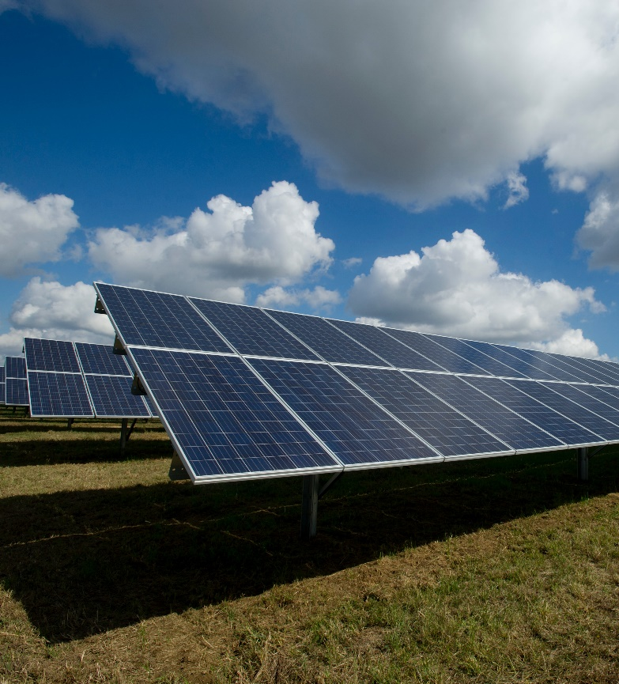
DECLINING COST OF GREEN ENERGY
CLEAN ENERGY OPTIONS
Renewable electricity costs have fallen sharply over the past decade, driven by improving technologies, economies of scale, increasingly competitive supply chains and growing developer experience.
Since 2010, the cost for construction of utility-scale solar photovoltaics (PV) power has declined by 82%, followed by concentrating solar power (CSP) at 47%, onshore wind at 39% and offshore wind at 29%.
Costs for solar and wind power technologies also continued to fall year-on-year.
Electricity costs:
Utility-scale solar PV fell 13% in 2019
Global average of 6.8 cents (USD 0.068) per kilowatt-hour (kWh).
Onshore and offshore wind both declined about 9%
Onshore - USD 0.053/kWh
Offshore - USD 0.115/kWh

Slide 5
GO GREEN, SAVE GREEN
ENERGY EFFICIENCY PROJECTS
“Define a repeatable sustainability process for ongoing projects for your organization.”
Creating a strategy that reduces your carbon footprint and increases energy efficiency is a multi-pronged approach that requires detailed planning and execution.
Identify – Benchmark energy usage across the organization and individual properties to determine the “current state” and prioritize “the energy hogs”.
Reduce – Audit the property and develop a list of engineered Energy Conservation Measures (ECM’s) that will cost-effectively impact the organization’s energy consumption.
Finance – Energy engineering can power the organization’s bottom line through creative financing and rebate options that eliminate the need for upfront capital while simultaneously increasing positive cash flow.

Slide 6
CURRENT STATE OF ENERGY EFFICIENCY
TOPICS TO BE DISCUSSED
During uncertain economic climates, some companies choose to halt projects to preserve critical capital.
Not always the best path!
Decrease operating expenses and improve net profit, without using capital, by implementing fast payback energy efficiency projects.
Creative financing options: Off-balance sheet funding, equipment lease financing, on-bill financing, C-PACE financing, etc.
Energy efficiency projects produce great ROI, reduce operating expenses, improve profitability, increase property value, improve occupant comfort, and reduce GHG emissions.
Reduce utility
spend by
up to 30%
a year.

Slide 7
SEE THE SAVINGS
ENERGY EFFICIENCY
COMMON AREA PROJECT EXAMPLE
LED Lighting Upgrade:
Annual savings exceed $14,700
Free utility rebates exceed $7,900
Payback in just 3.2 years
Reduce the property’s carbon footprint by more than 108,000 pounds of CO2 annually
Transitioned to 100% green energy through a long-term supply agreement. 3-year savings of approx. $7000!

Slide 8
SEE THE SAVINGS
ENERGY EFFICIENCY
ENERGY EFFICIENCY EXAMPLE PROJECT
LED Lighting Upgrade:
Annual Savings: $103,531
Payback: 2.6 years
Mechanical Upgrade: Upgrade main and west dust collection systems
Annual Savings: $94,144
Payback: 3.5 years
Renewables: Rooftop solar (photovoltaic)
No Cost – Power Purchase Agreement
Immediate payback with annual estimated savings of $12,000
Total annual energy savings from the project exceed $200,000.
Implementing this project will reduce the facility’s carbon footprint by approximately 3.5 million pounds of CO2 annually.

Slide 9
PARTIAL LIST OF ECMS PROVIDED BY EEP
VARIOUS OPTIONS DEPENDING ON PROPERTY TYPE AND PAYBACK (ROI) REQUIRED
LED Lighting Retrofits, Upgrades and Controls
Intelligent HVAC/R Controls
Boiler Plant and Chiller Plant Upgrades
Free Cooling/Expanded Economizer Logic
Building Envelope Solutions
Peak Load Management
Demand Controlled Ventilation (DCV)
Variable Speed/Frequency Drives
Electronically Commutated Motors (ECM)
Ultrasonic Leak Detection and Remediation
Intelligent Thermostats
Time Delay Relays
Combined Heat & Power (CHP – cogen/trigen)
Building Automation/Energy Management Systems
Frequency Regulation and Battery Storage
Demand Response Programs
Data Center Containment Solutions
Equipment Replacements/Upgrades
Photovoltaic, Solar Hot Water, Geothermal
Radiant Heating
Energy Benchmarking and Local Law Compliance
Thermal Qualities Simulation
Heat Recovery and Re-Use
Liquid Pool Cover
Kitchen Hood Controls
And More!!

Slide 10
GREEN FINANCING
FINANCING OPTIONS
Equipment Leasing, Bank Financing, Low/Zero Interest Loans: Financing covers 100% of the project costs and is paid back over a predetermined period of time between 24-72 months. There are a variety of financing structures such as monthly or quarterly payments, deferred payments, step payments, etc. All payments are tax deductible as capital payments.
On-Bill Funding: On-bill funding provides 100% project funding paid back through your monthly electric or gas bill. Repayments are considered an operational expense. Flexible term structures from 36 to 60 months. If you are currently under contract with a 3rd party supplier for your electric or gas, you can get your efficiency solutions implemented today but delay payments for up to 24 months.
C-PACE Financing: Commercial Property Assessed Clean Energy financing is a financing structure through which building owners can finance energy projects via an assessment on their property tax bill. The benefits of C-PACE include zero up-front capital, re-payments qualify as an operational expense, obligation transfers to the new owner after sale of the property, and up to a 25-year term with low interest rates dramatically increases positive cash flow.
Energy service agreements (ESA), power purchase agreement (PPA), energy as a service (EaaS)..

Slide 11
WHAT ARE THE NEXT STEPS?
FINAL POINTS
Understand the high ROI Energy Conservation Methods (ECMs). No-obligation energy audit: Identify energy hogs to reduce consumption.
Be aware of the current energy market. Lock in long-term contracts to reduce risk.
Reach your sustainability goals, while saving money. Green energy procurement and community ESG goals.

Slide 12
ANY QUESTIONS?
THANK YOU FOR HAVING US!
ANY QUESTIONS?
Jack Robbins

